Slide 1

Time Complexity
CISC 3220 Lecture 2
By Ariel Avshalom

Slide 2
Highest exponent
When analyzing algorithms, the general case is that the higher exponent variable matters more than all other terms
Why do you think this is the case?

Slide 3
Wait, so no other terms matter?

Slide 4
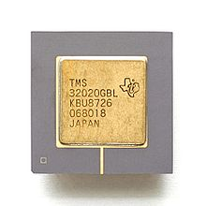

Let’s paint a story
Check out this handy Wikipedia entry about the evolution of computer speed
Consider the Texas TMS320 core and compare it to the AMD Ryzen ThreadRipper
TMS320 has 5 MIPS (million instructions per second)
The ThreadRipper has about 2,400,000 MIPS
Probably the best chip set out there
Comparative chips have about 700,000 and 400,000 MIPS
Let’s play a speed game with algorithms

Slide 5
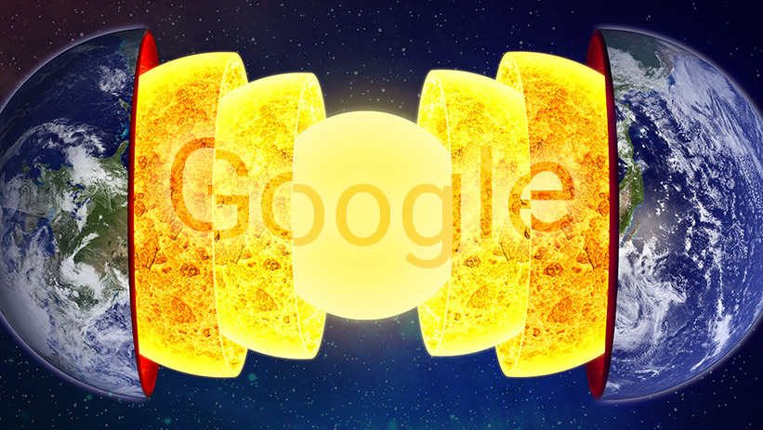
So you see
When looking at large computations, which is what often happens in the real world (think Google) the highest exponent becomes the most important measurement
It’s nice to be able to do an exact analysis, and we may do this during examinations (and you might do so in interviews), but it doesn’t matter much

Slide 6
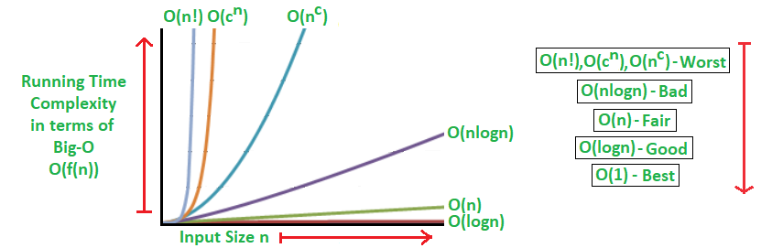
Hierarchy of Functions
There is a hierarchy of functions which increase with a rising exponent
Part of your first homework will be to order a bunch of these
Here is how it’ll look

Slide 7
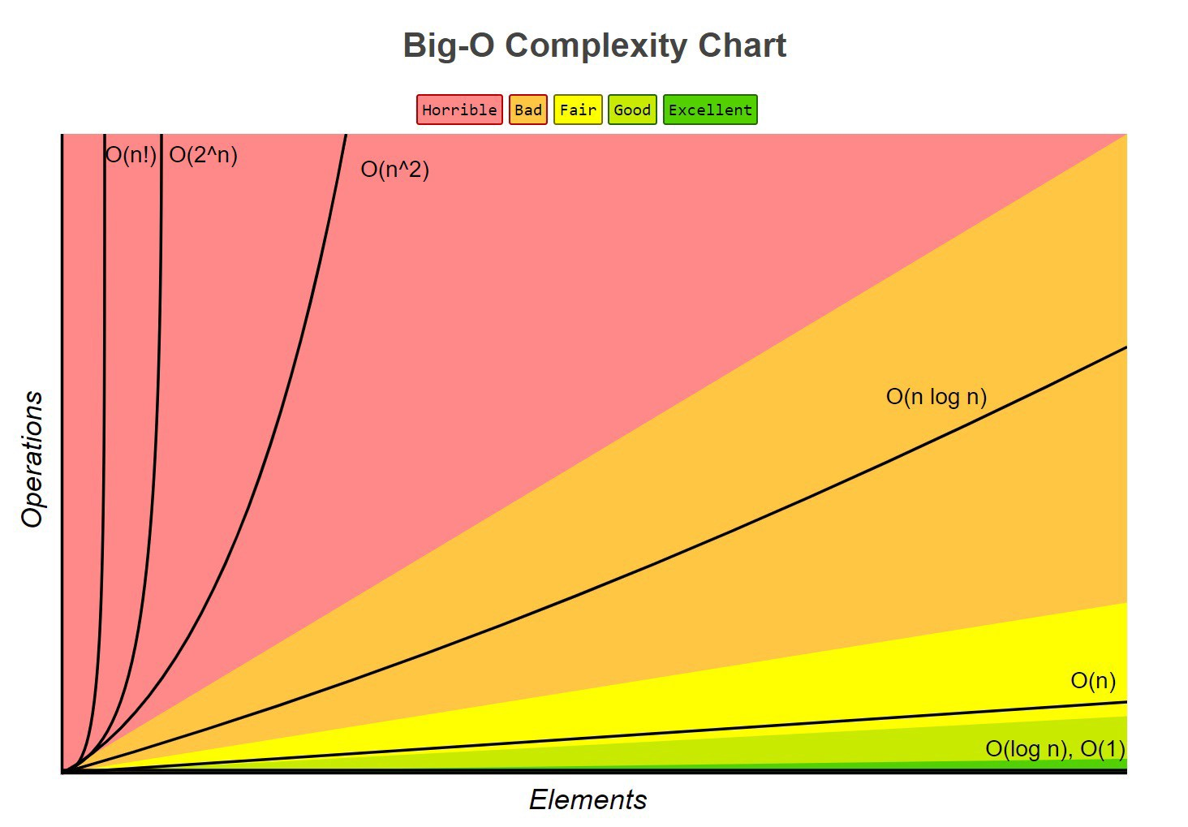

Slide 8
Running Time | 1 second | 1 minute | 1 hour
400n | 2500 | 150,000 | 9,000,000
2n^2 | 707 | 5477 | 42426
n^4 | 31 | 88 | 244
2^n | 19 | 25 | 31
Note: Each operation takes 1 microsecond

Slide 9

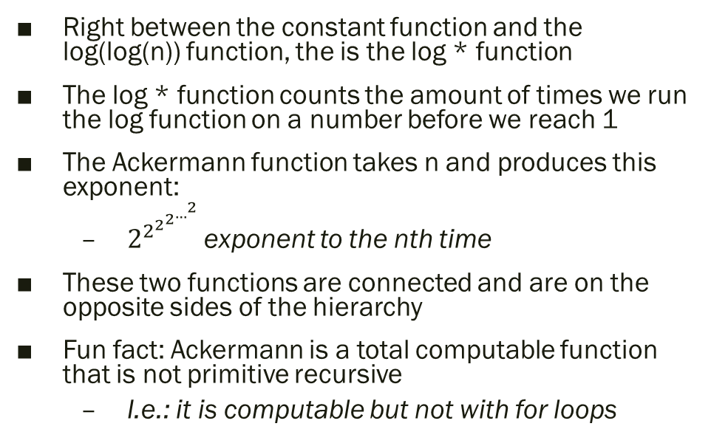
An interesting function comparison log * (n) and Ackermann
Right between the constant function and the log(log(n)) function, the is the log * function
The log * function counts the amount of times we run the log function on a number before we reach 1
The Ackermann function takes n and produces this exponent:
$2^{2^{2^{2^{…^{2}} }}}$exponent to the nth time
These two functions are connected and are on the opposite sides of the hierarchy
Fun fact: Ackermann is a total computable function that is not primitive recursive
I.e.: it is computable but not with for loops

Slide 10
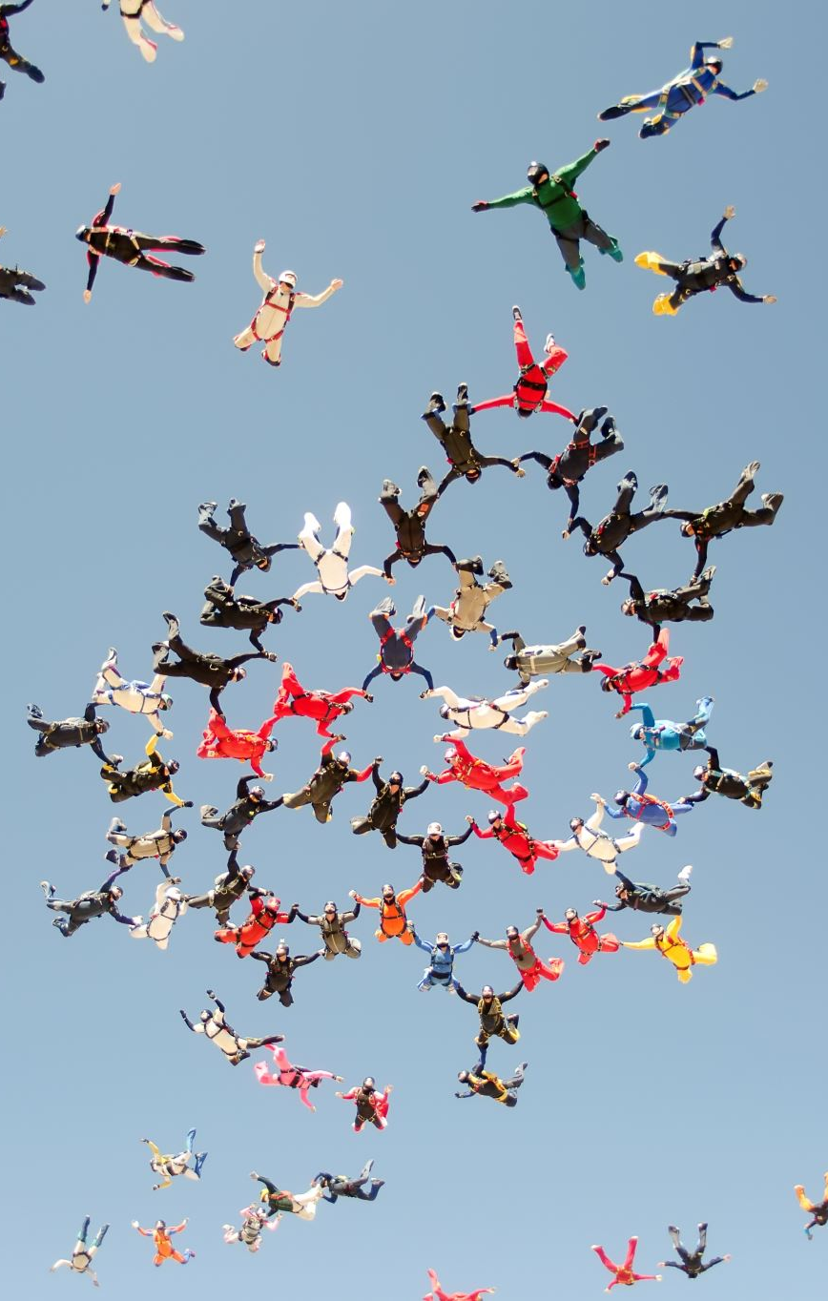
Highly efficient ancient algorithms
Consider this a break
We already saw the Babylonian Multiplication Algorithm, but two really useful ones are Euclid’s Greatest Common Divisor Algorithm and the Sieve of Eratosthenes
We are splitting the class into two groups: Group 1: A-M, Group 2: N-Z
Group 1 will check out Euclid’s algorithm and Group 2 will explore the Sieve
You will post what you find on OneNote
You can either go online and research or watch the videos above
You have 10 minutes
Team with the most useful information gets 2 points on next quiz
It’s not a lot of points but it makes the game interesting

Slide 11
Segway to O-notation
Watch this video by Gayle Laakmaan Mcdowell which introduces big O notation:
https://www.youtube.com/watch?v=v4cd1O4zkGw

Slide 12
O, Ω and Θ

Slide 13
Big O and little o notation
Big O is written like so:
F(n) = O(g(n)) if f(n) is asymptotically less than or equal to g(n)
It is the asymptotic upper bound
Little o is written like so:
F(n) = o(g(n)) if f(n) is asymptotically strictly less than g(n)
We rarely ever use little o notation (but it can appear in exams and homework)

Slide 14
Ω and ω (little omega) notation
Big Ω is written like so:
F(n) = Ω (g(n)) if f(n) is asymptotically greater than or equal to g(n)
It is the asymptotic upper bound
Little ω is written like so:
F(n) = ω(g(n)) if f(n) is asymptotically strictly greater than g(n)
We rarely ever use little ω notation (but it can appear in exams and homework)
Ω is similar to O except that it is the asymptotic lower bound

Slide 15
Θ notation
This is the middle ground
F(n) = Θ(g(n)) if f(n) is asymptotically equal to g(n)

Slide 16
Ok, so how do I understand this?
By doing problems involving all of the five principles above
By avoiding the strange math notation and focusing on growth of functions really means

Slide 17
Some problems

Slide 18
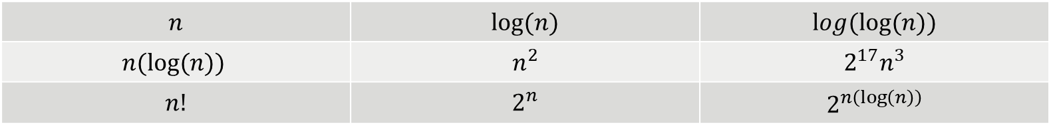
Organize the following by the increasing order of their growth
$$n$$ | $$log⁡(n)$$ | $$log(log⁡(n))$$
$$n(log⁡(n))$$ | $$n^{2}$$ | $$2^{17}n^{3}$$
$$n!$$ | $$2^{n}$$ | $$2^{n\left(\log\left(n\right)\right)}$$
Can you see how each of these can represent an O or Ω equivalent of the other?

Slide 19
